Slide 1

Team Name : Smart Shift
Team Leader Name : Ritu Ranjan
Problem Statement : Simulation/Modelling of forest spread using AI/ML techniques

Slide 2

Team Members
Team Leader: Name: Ritu Ranjan College: IIT Patna | Team Member-1: Name: Anjali Ray College: IIT Patna
Team Member-2: Name: Shaik Sameer College: IIT Patna | Team Member-3: Name: Milan Raj College: Chandigarh University

Slide 3
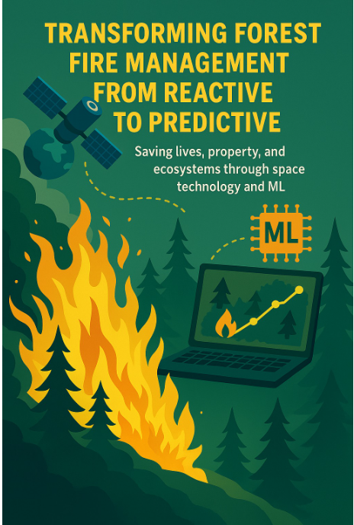
Brief about the Idea:
VISION
"Transform forest fire management from reactive to predictive, saving lives, property, and precious ecosystems through space technology and Machine learning. “
THE PROBLEM –
India faces a massive forest fire crisis:
16,300 hectares of forest are lost annually to wildfires in India (WRI estimate).
₹1.74 lakh crore ($21 billion USD) economic damage yearly
Massive biodiversity loss and wildlife habitat destruction
Air quality degradation affecting over 600,000 people
OUR SOLUTION
Smart Early-Warning System for Forest Fire Prediction
A predictive system that:
Analyzes weather conditions (temperature, humidity, wind)
Monitors vegetation health using satellite-based NDVI data
Applies Machine Learning to predict fire risk for any location
Visualizes fire risk through interactive maps and heatmap grids
Enables authorities to identify high-risk areas early for prevention & preparedness
Our Goal: Reduce fire incidents by 60% and save ₹1.74 lakh crore annually while protecting precious ecosystems, biodiversity, and human lives through predictive intelligence and early intervention.

Slide 4
Opportunity should be able to explain the following:
How different is it from any of the other existing ideas?
Traditional systems rely on satellite fire detection only after a fire has started, use static risk zones with limited coverage, and provide binary risk assessments. Our innovation allows users to select specific geographic coordinates for pre-fire prediction, integrating real-time weather data, vegetation indices, and a machine learning model to generate fire probability percentages along with wind direction and temperature. It also identifies and displays the corresponding state and area name for the provided latitude and longitude, offering dual visualization through both map and grid views.
How will it be able to solve the problem?
Predicts fire before it starts - enables early warning and proactive resource deployment
Location-specific assessment - percentage-based risk for any coordinates with risk-based surveillance
Visual decision support - interactive maps + heatmap grids help officials act quickly and understand risky zones clearly.
USP of the proposed solution
Works with any location entered by user
Combines weather + vegetation + AI in one tool
Shows fire percentage, not just binary risk
Includes wind direction for fire spread insight
Designed for easy deployment on basic hardware or cloud infrastructure

Slide 5
List of features offered by the solution
Our machine learning-driven fire risk prediction system transforms forest fire management through intelligent data integration and predictive analytics. The solution combines real-time weather monitoring, vegetation health analysis, and machine learning to deliver accurate fire risk assessments with 85-90 % model accuracy, predicting correct outputs every time. Users can input any location coordinates to receive comprehensive risk analysis through interactive visualizations and exportable reports, enabling authorities to track potential fire zones and proactively save forests from devastating fires. This system helps preserve precious ecosystems and prevent massive economic losses by shifting from reactive firefighting to predictive prevention.
KEY FEATURES
Location Intelligence
Accepts any global coordinates (latitude/longitude) and identifies area names through reverse geocoding.
Real-Time Data Integration
Fetches live weather data (temperature, humidity, wind) via OpenWeatherMap API and monitors vegetation health using NDVI data.
Machine learning Powered Prediction
Trains Random Forest model on environmental conditions to calculate fire risk probability and predict high-risk zones with high accuracy.
Interactive Visualization
Creates color-coded maps (🟢 low risk, 🔴 high risk) with fire percentages and wind direction indicators for precise risk assessment.
Scientific Heatmap Generation
Generates NDVI vegetation heatmaps and fire probability grids for comprehensive risk distribution mapping.

Slide 6
Process flow
Step 1: Location Input & Geographic Coordinates
User inputs precise geographic coordinates (full latitude and longitude) to define the target area for fire risk assessment and monitoring.
Step 2: Real-Time Weather Data Acquisition
Advanced weather data is fetched via Open weather APIs, including temperature, humidity, wind speed, wind direction, and atmospheric pressure parameters.
Step 3: Vegetation Health Analysis
NDVI (Normalized Difference Vegetation Index) grid is generated to simulate and assess vegetation density, moisture content, and overall ecosystem health across the target area.
Step 4: ML Model Training & Risk Assessment
Random Forest model analyzes temperature, humidity, wind patterns, and NDVI values to predict fire risk for each grid cell with enhanced accuracy.
Step 5: Fire Risk Prediction & Zone Identification
Calculates fire probability and identifies high-risk zones with 85-90% accuracy for proactive disaster management.
Step 6: Interactive Visualization & Reporting
Creates color-coded risk maps (🟢 low | 🔴 high) with detailed popups, NDVI heatmaps, and comprehensive risk analysis for stakeholders.

Slide 7
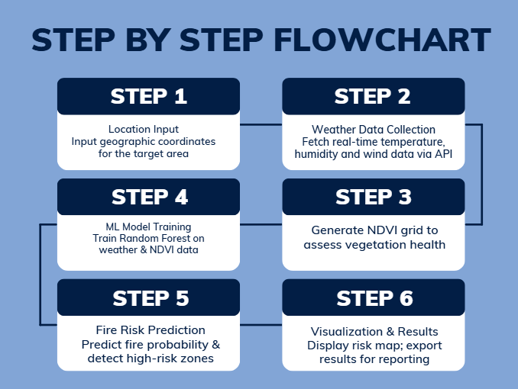
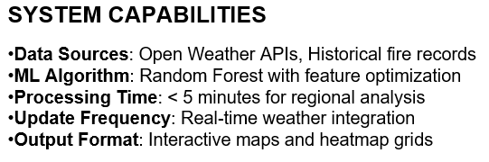
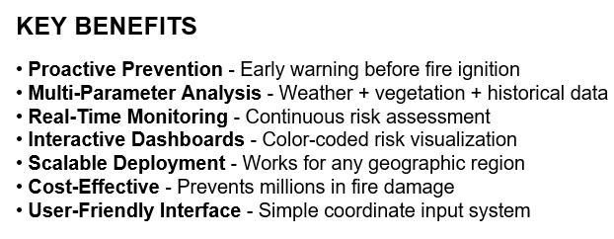
Architecture diagram of the solution

Slide 8
Technologies to be used in the solution:
Our forest fire prediction system leverages cutting-edge technologies and libraries to deliver accurate risk assessment and intuitive visualization:
Tool/Library | Purpose
Python | Core programming language for model development
NumPy, Pandas | Data manipulation, processing, and grid generation
scikit-learn | Machine learning implementation (Random Forest classifier)
Folium | Interactive mapping and geospatial visualization
Matplotlib | Statistical plotting and heatmap generation
OpenWeatherMap API | Real-time weather data acquisition
Nominatim (OpenStreetMap) | Reverse geocoding and location services
Google Collab / Jupyter | Development environment and model testing

Slide 9
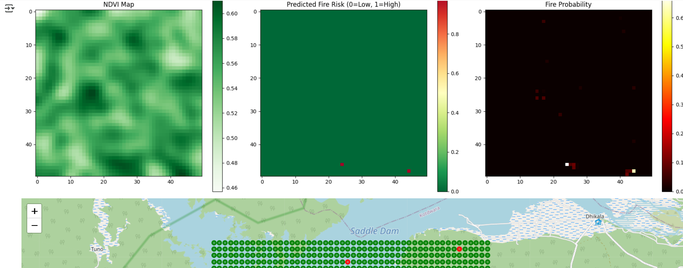
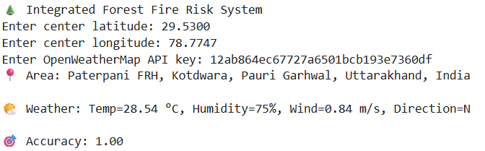
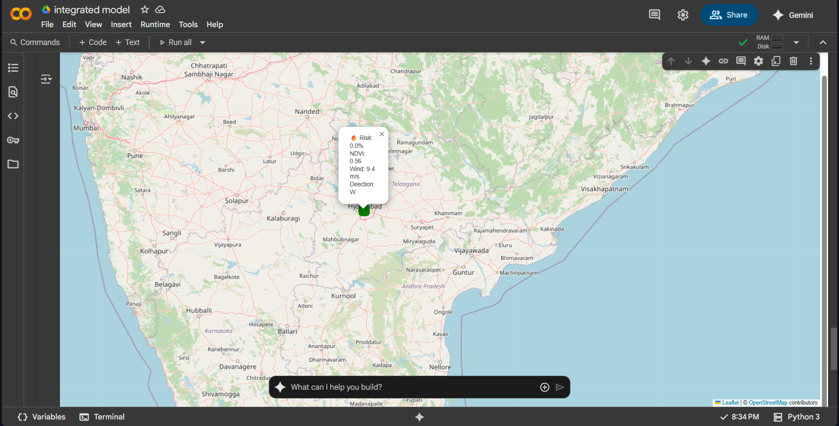
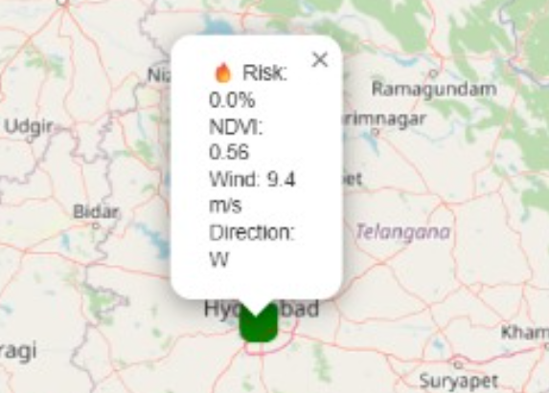
Output images
The model outputs demonstrate high prediction accuracy (1.00) with detailed fire risk visualization, probability mapping, and real-time weather integration for effective forest fire monitoring.
It generates precise risk maps and probability distributions for the targeted geographic region.
Zoomed-In View

Slide 10
Future Enhancement
Our forest fire prediction model currently achieves high accuracy and provides reliable risk assessment. To further enhance its capabilities and create a comprehensive forest fire management system, we plan to implement the following improvements:
Planned Developments:
Real-time Satellite Integration - Incorporate live NDVI data from MODIS and Sentinel satellites for enhanced vegetation monitoring
Automated Alert System - Implement SMS and email notifications to forest authorities and emergency services for immediate response
Early Warning Fire Risk System - Develop predictive algorithms that analyze weather patterns, humidity levels, wind conditions, and vegetation dryness to provide advance warnings of potential fire risks before ignition occurs
Live Fire Detection Integration - Connect with NASA FIRMS and JPSS systems for real-time fire validation and monitoring
Interactive Dashboard - Develop mobile and web applications for forest departments and public accessibility
Advanced Terrain Analysis - Include elevation, slope, and topographical data to improve prediction accuracy
Deep Learning Implementation - Upgrade to advanced neural networks for complex terrain analysis and temporal pattern recognition
Cloud Deployment - Deploy on AWS/Azure for 24/7 monitoring and scalable emergency response

Slide 11


Slide 12
Wireframes/Mock diagrams of the proposed solution (optional)

